Slide 1

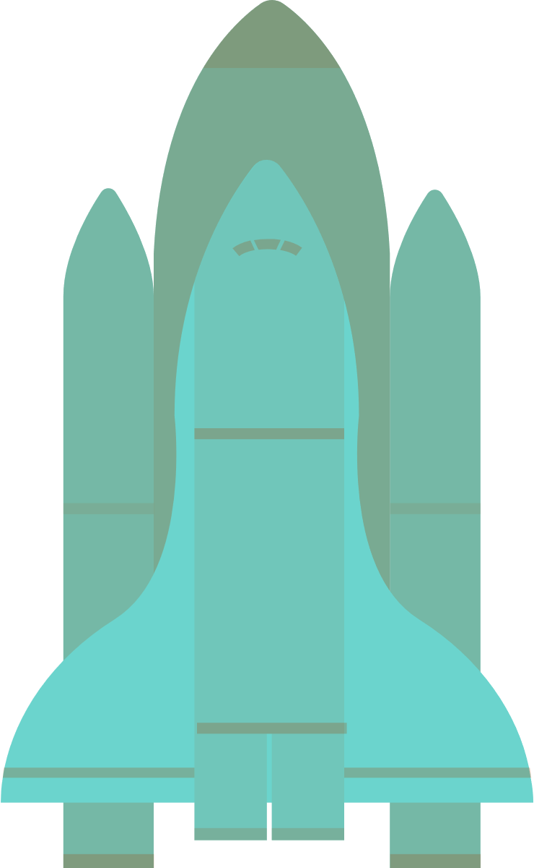

2023
DEMO SESSION FOR DORAHACKS:
OUTFITTING A MARS HABITAT
tAMing particles
the winners of Best Use of Technology at NASA Space Apps 2022 challenge.

Slide 2
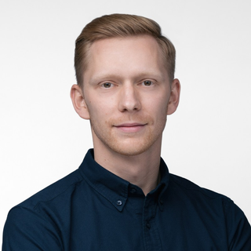


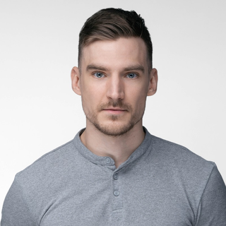
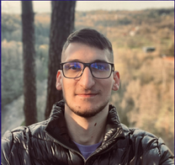
THE TEAM
tAMing particles
Domas G. - Process Manager at Kongsberg NanoAvionics
Karolis S. - Director of Engineering Ops at Kongsberg NanoAvionics
Justas M. - Mechanical design engineer at NanoAvionics
Paulius B. - Mechanical design engineer at NanoAvionics
Kipras P. - Mechanical Engineering student

Slide 3


The challenge
OUTFITTING A MARS HABITAT.
Imagine you’re an astronaut who has newly arrived on the Red Planet. Your habitat has been pre-constructed for you, but, other than three 3-D printers, it doesn’t have most of the things you need to live and work. Your challenge is to design tools, furniture, and other items to assist you on your one-year mission.
Additionally, it is crucial to design a replacements rover wheel, which was damaged during landing.
TAMING PARTICLES 2022

Slide 4
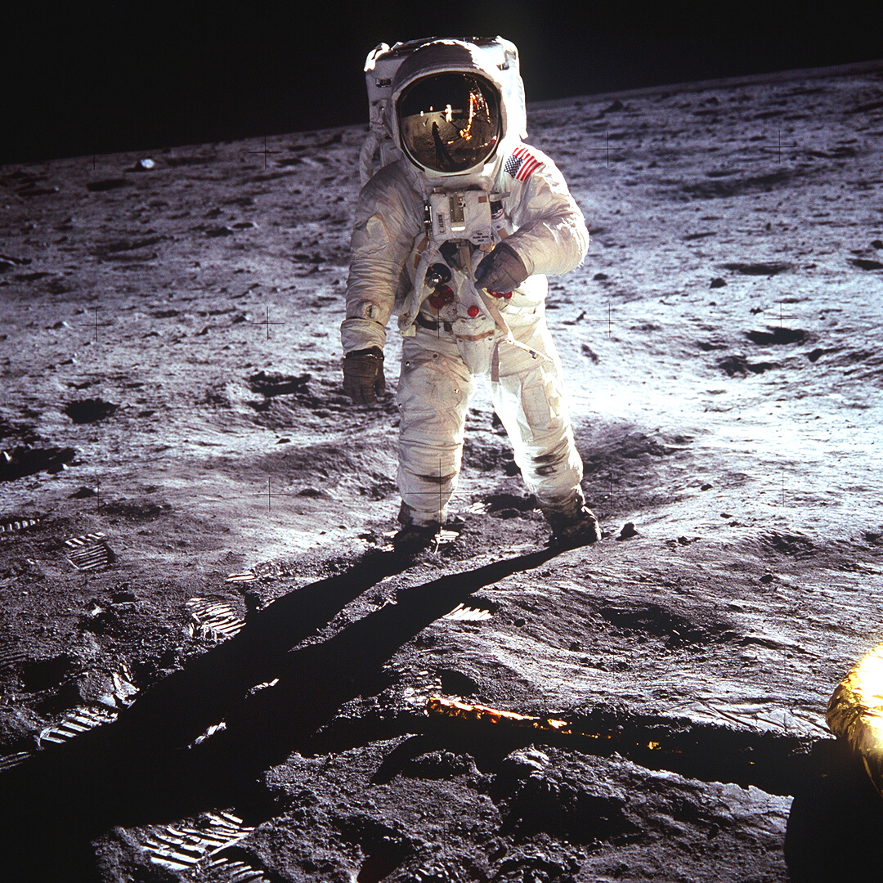
Our approach
There are many parts that can be built. Choosing a particular one might be overwhelming.
To solve this we are building a product catalog and assembly structure.
In addition we are giving an example of this system with modular parts.
Topology optimisation can be done manually for each part or a script could be written which would optimise parts automatically.
TAMING PARTICLES 2022

Slide 5
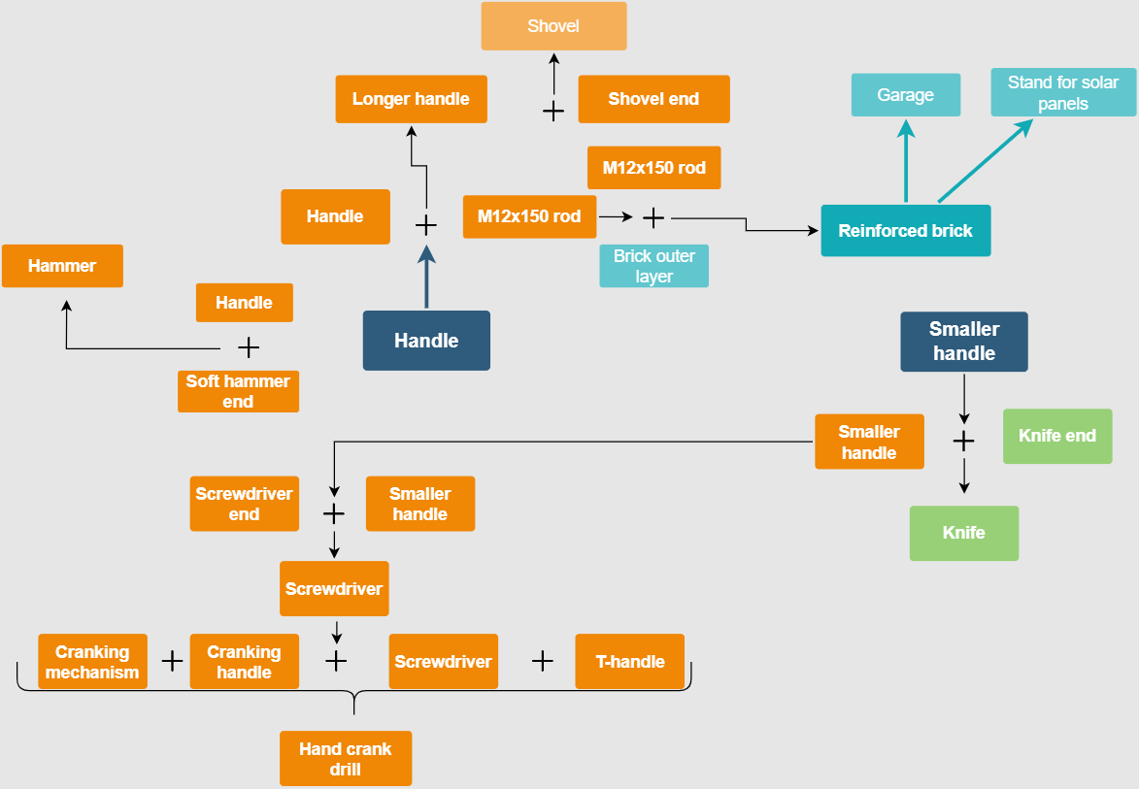
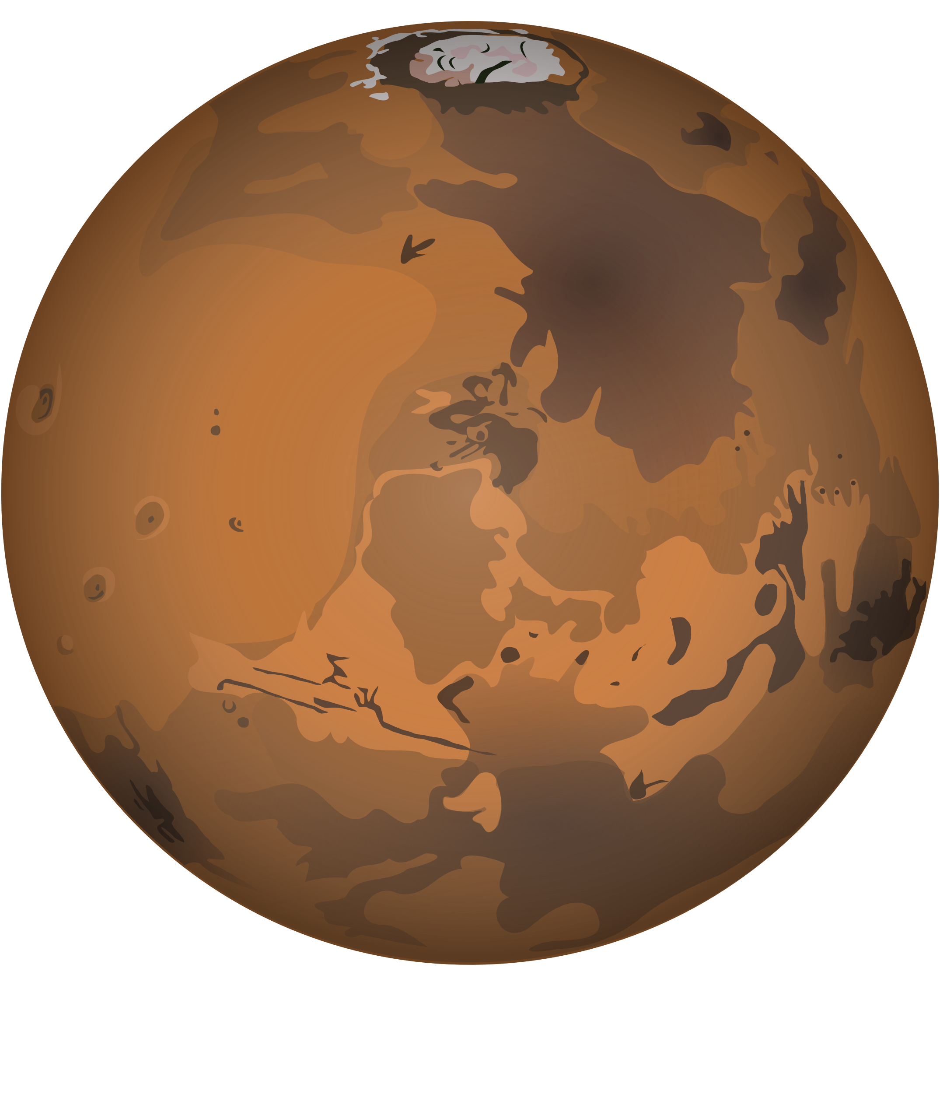
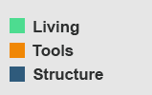
STRUCTURE
Notes:
Tools list done according to
NASA's report on Deep Space Habitability Design Guidelines Based on the NASA NextStep Phase 2 Ground Test Program.
Show excel with more parts
https://docs.google.com/spreadsheets/d/1KexUiFHVwFiIOf7H-w7W6lXTwijjgMINY08FUsNS7cw/edit#gid=0

Slide 6

EXAMPLE OF THE STRUCTURE IN ACTION

Slide 7
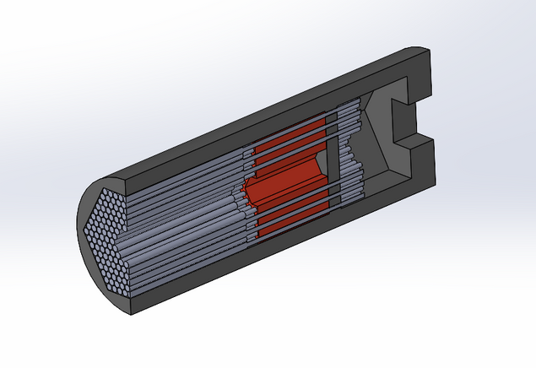
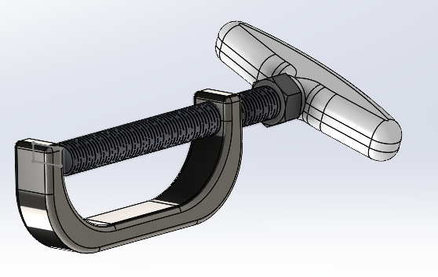
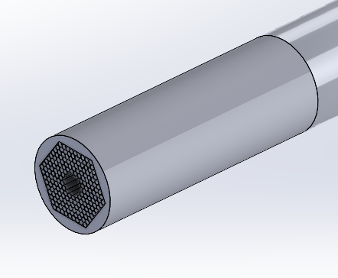
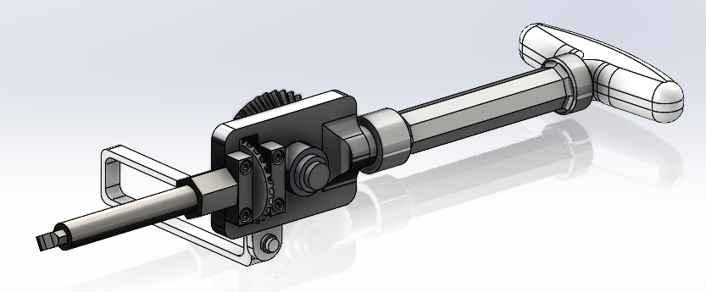
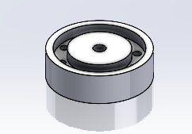
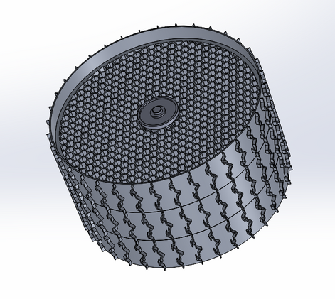
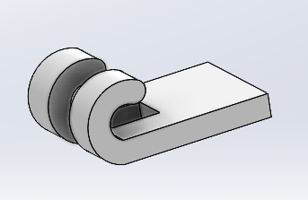
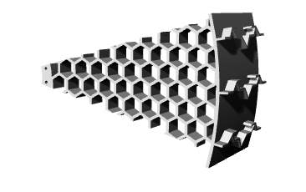
Other parts examples

Slide 8
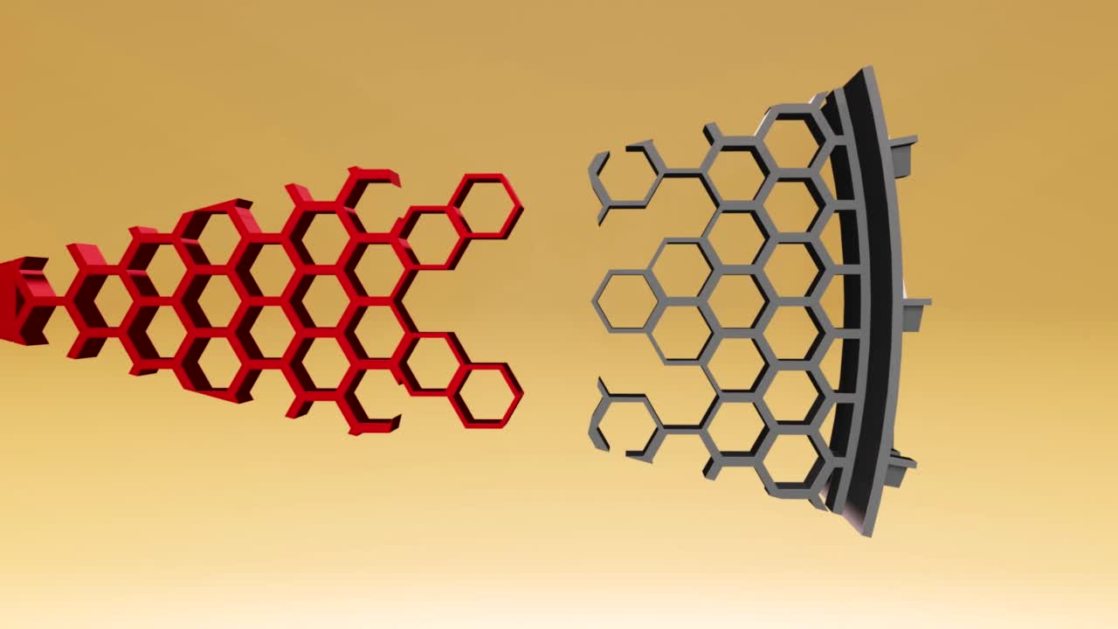
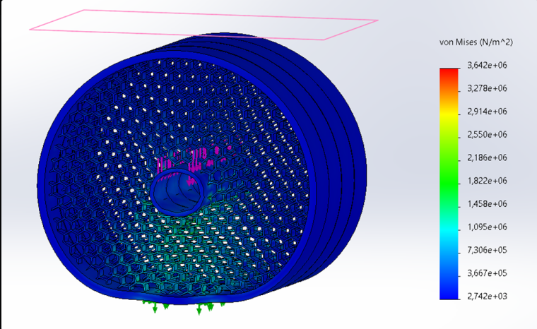

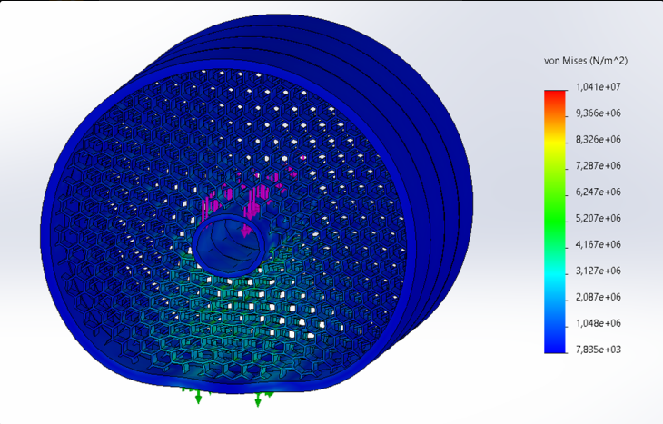
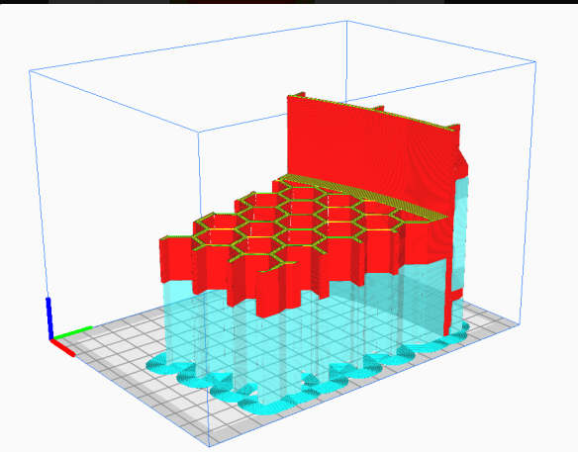
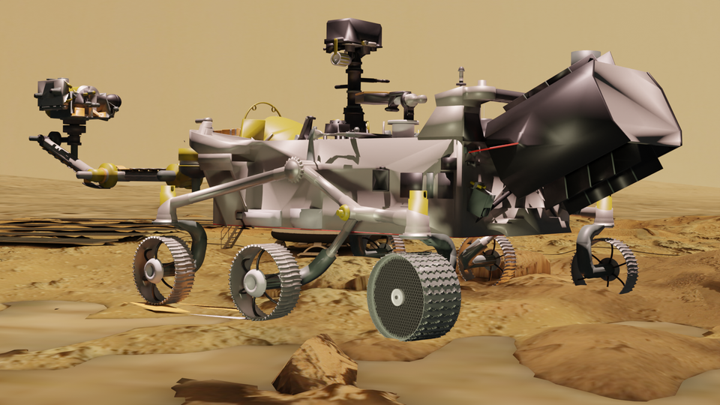
ROVER WHEEL
σ yield = 13,5 MPa
Stress on Mars
FITS GOOD AS NEW
ALL PARTS FIT ON THE BUILD PLATE
Stress on Earth

Slide 9
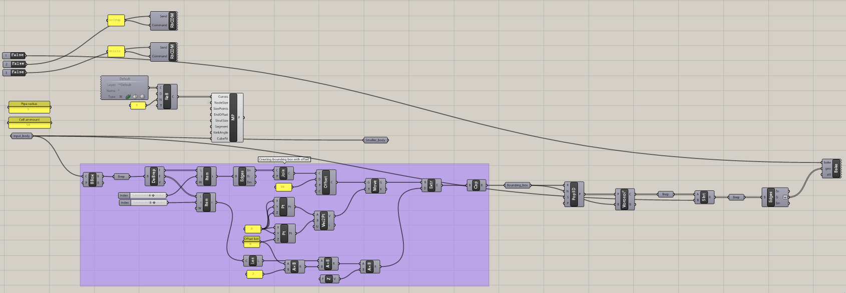
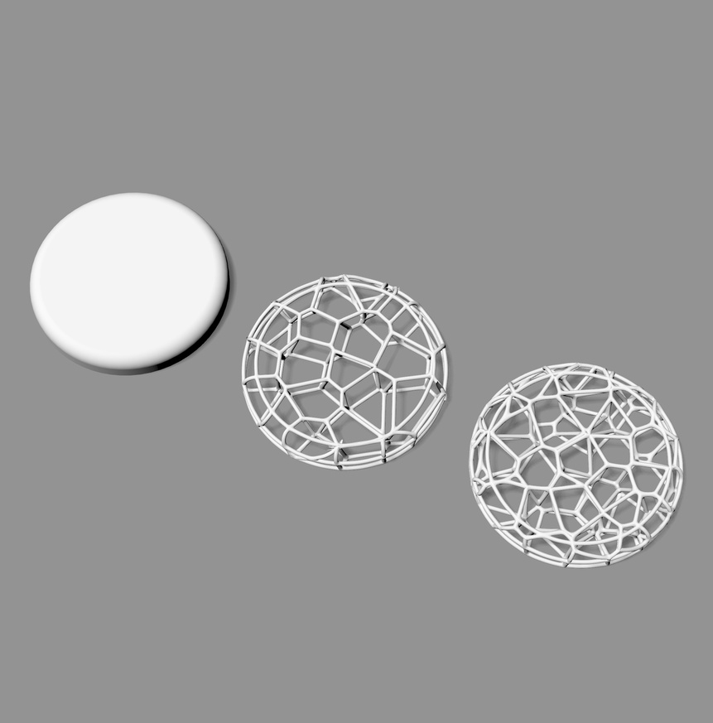
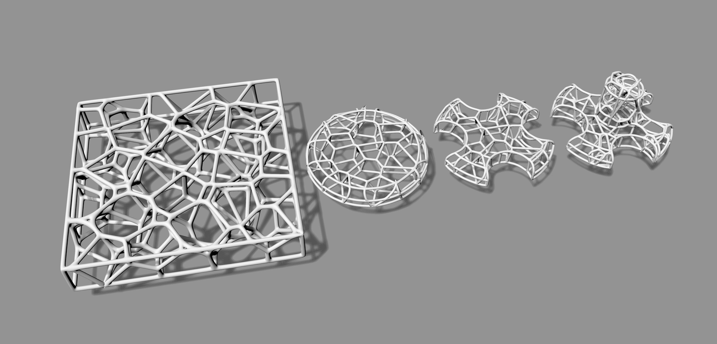
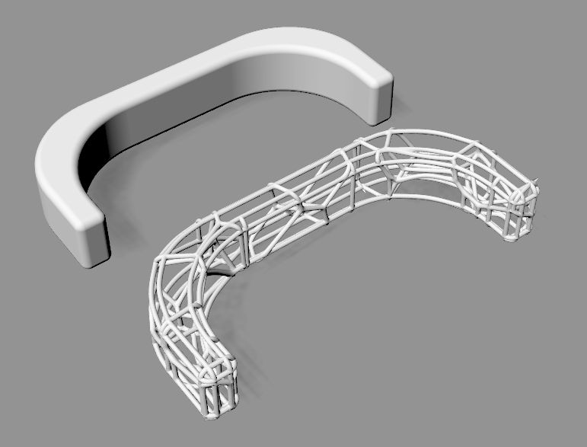

TOPOLOGY OPTIMISATION
IMPORT SOLID PART
CHOOSE PARAMETERS:
- PIPE DIAMETER
- CELL AMOUNT
GATHER SEGMENTED PART

Slide 10
Discussion

